Slide 1
IT Act 2000/2008

Slide 2
Section 43 - Penalty and compensation for damage to computer, computer system, etc.
If any person without permission of the owner or any other person who is in-charge of a computer, computer system or computer network, or computer resource —
Unauthorized access computer, computer system or computer network;
downloads, copies or extracts any data, computer data base or information from such computer, computer system or computer network including information or data held or stored in any removable storage medium;
introduces or causes to be introduced any computer contaminant or computer virus into any computer, computer system or computer network;

Slide 3
damages or causes to be damaged any computer, computer system or computer network, data, computer data base or any other programmes residing in such computer, computer system or computer network;
disrupts or causes disruption of any computer, computer system or computer network;
Denies or causes the denial of access to any person authorized to access any computer, computer system or computer network by any means; provides any assistance to any person to facilitate access to a computer, computer system or computer network in contravention of the provisions of this Act, rules or regulations made thereunder;
Charges the services availed of by a person to the account of another person by tampering with or manipulating any computer, computer system, or computer network, he shall be liable to pay damages by way of compensation to the person so affected.
destroys, deletes or alters any information residing in a computer resource or diminishes its value or utility or affects it injuriously by any means;
steal, conceals, destroys or alters or causes any person to steal, conceal, destroy or alter any computer source code used for a computer resource with an intention to cause damage;
imprisonment for a term which may extend to three years or with fine which may extend to five lakh rupees or with both.

Slide 4
Section 65 – Tampering with computer source documents
Whoever knowingly or intentionally conceals, destroys or alters or intentionally or knowingly causes another to conceal, destroy, or alter any computer source code used for a computer, computer program, computer system or computer network, when the computer source code is required to be kept or maintained by law for the time being in force, shall be punishable.
Imprisonment up to three years, or with fine which may extend up to two lakh rupees, or with both.

Slide 5
Section 66A – Punishment for sending offensive messages through communication service
Any information that is grossly offensive or has menacing character; or
Any information which he knows to be false, but for the purpose of causing annoyance, inconvenience, danger, obstruction, insult, injury, criminal intimidation, enmity, hatred or ill will, persistently by making use of such computer resource or a communication device; or
Any electronic mail or electronic mail message for the purpose of causing annoyance or inconvenience or to deceive or to mislead the addressee or recipient about the origin of such messages.
Shall be punishable with imprisonment for a term which may extend to three years and with fine.

Slide 6
Section 66B – Punishment for dishonestly receiving stolen computer
Whoever dishonestly received or retains any stolen computer resource or communication device knowing or having reason to believe the same to be stolen computer resource or communication device, shall be punished.
Imprisonment of either description for a term which may extend to three years or with fine which may extend to rupees one lakh or with both.

Slide 7
Section 66C & 66D – Punishment for identity theft
Whoever, fraudulently or dishonestly make use of the electronic signature, password or any other unique identification feature of any other person, shall be punished.
Imprisonment of either description for a term which may extend to three years and shall also be liable to fine with may extend to rupees one lakh.

Slide 8
Section 66E – punishment for violation of privacy
Whoever, intentionally or knowingly captures, publishes or transmits the image of a private area of any person without his or her consent, under circumstances violating the privacy of that person, shall be punished.
Imprisonment which may extend to three years or with fine not exceeding two lakh rupees, or with both.

Slide 9
Section 67 – punishment for publishing or transmitting obscene material in electronic form
Whoever publishes or transmits or causes to be published or transmitted in the electronic form, any material which is lascivious or appeals to the prurient interest or if its effect is such as to tend to deprave and corrupt persons who are likely, having regard to all relevant circumstances, to read, see or hear the matter contained or embodied in it, shall be punished.
First conviction with imprisonment of either description for a term which may extend to three years and with fine which may extend to five lakh rupees or both.
In the event of second or subsequent conviction with imprisonment of either description for a term which may extend to five years and also with fine which may extend to ten lakh rupees.

Slide 10
Section 67a – punishment for publishing or transmitting of material containing sexually explicit act
Whoever publishes or transmits or causes to be published or transmitted in the electronic form any material which contains sexually explicit act or conduct shall be punished.
First conviction with imprisonment of either description for a term which may extend to five years and with fine which may extend to ten lakh rupees or both.
In the event of second or subsequent conviction with imprisonment of either description for a term which may extend to seven years and also with fine which may extend to ten lakh rupees

Slide 11
Section 67B – punishment for publishing or transmitting of material depicting child in sexually explicit act
First conviction with imprisonment of either description for a term which may extend to five years and with fine which may extend to ten lakh rupees.
In the event of second or subsequent conviction with imprisonment of either description for a term which may extend to seven years and also with fine which may extend to ten lakh rupees.

Slide 12
Section 71 – penalty for misrepresentation
Whoever makes any misrepresentation to, or suppresses any material fact from the Controller or the Certifying Authority for obtaining any licence or [Electronic Signature] Certificate, as the case may be, shall be punished.
Imprisonment for a term which may extend to two years, or with fine which may extend to one lakh rupees, or with both.

Slide 13
Section 72 – penalty for breach of confidentiality and privacy
If any person who, in pursuance of any of the powers conferred under this Act, rules or regulations made thereunder, has secured access to any electronic record, book, register, correspondence, information, document or other material without the consent of the person concerned discloses such electronic record, book, register, correspondence, information, document or other material to any other person shall be punished.
Imprisonment for a term which may extend to two years, or with fine which may extend to one lakh rupees, or with both.

Slide 14
Section 72a – punishment for disclosure of information in breach of lawful contract
Any person including an intermediary who, while providing services under the terms of lawful contract, has secured access to any material containing personal information about another person, with the intent to cause or knowing that he is likely to cause wrongful loss or wrongful gain discloses, without the consent of the person concerned, or in breach of a lawful contract, such material to any other person, shall be punished.
Imprisonment for a term which may extend to three years, or with fine which may extend to five lakh rupees, or with both.

Slide 15
Section 74 – publication for fraudulent purpose
Whoever knowingly creates, publishes or otherwise makes available a [Electronic Signature] Certificate for any fraudulent or unlawful purpose shall be punished.
Imprisonment for a term which may extend to two years, or with fine which may extend to one lakh rupees, or with both.

Slide 16
Auditing Standards and Frameworks

Slide 17
Overview
It identifies both good practice and where practice needs to improve through a systematic approach to sampling files.
It provides senior management with assurance as to the quality of our work.

Slide 18
ISO/IEC 27001
ISO/IEC 27001 is the international standard for information security.
It sets out the specification for an effective ISMS (information security management system).
The Standard has ten management system clauses : Scope, Normative references, Terms and definitions, Context of the organization, Leadership, Planning, Support, Operations, Performance evaluation, Improvement

Slide 19
COBIT
It stands for Control Objectives for Information and Related Technologies.
The COBIT framework was created by ISACA to bridge the crucial gap between technical issues, business risks and control requirements.
COBIT is based on five principles: meeting stakeholder needs, covering the enterprise end-to-end, applying a single integrated framework, enabling a holistic approach, and separating governance from management.

Slide 20
HIPAA
It stands for Health Insurance Portability and Accountability Act.
The Health Insurance Portability and Accountability Act (HIPAA) enacted in 1996 is a set of regulatory standards that aims at safeguarding sensitive patient data from healthcare providers.
It is a United States Act of Congress enacted by the 104th United States Congress and signed into law by President Bill Clinton on August 21, 1996.
India has its own HIPAA equivalent, the Digital Information Security in Healthcare Act (DISHA). DISHA aims to provide healthcare data security, confidentiality, standardization, and privacy.

Slide 21
GDPR
The General Data Protection Regulation (GDPR) is a European law that sets guidelines for the collection and processing of personal data.
The GDPR was approved in 2016 and went into effect in 2018.
It replaces the EU Data Protection Directive of 1995.
India has followed the EU's GDPR in allowing global digital companies to conduct business under certain conditions. The GDPR applies to Indian companies if they target EU individuals or monitor their behavior.
India's Digital Personal Data Protection (DPDP) Act, 2023 is similar to the European Union's (EU) General Data Protection Regulation (GDPR). The DPDP Act is India's first cross-sectoral law on personal data protection. It applies to all organizations that process personal data of individuals located in India, regardless of the organization's location.

Slide 22
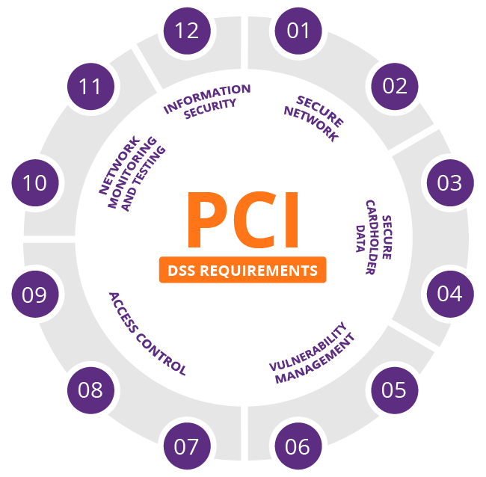
PCI DSS
It stands for Payment Card Industry Data Security Standard.
PCI DSS compliance is a set of requirements for companies that process, store, or transmit credit card information. It's a global security standard that sets a baseline level of protection for consumers and helps reduce fraud and data breaches.

